Slide 1
LECTURE 12:CYCLIC REDUNDANCY CHECK CODE(CRC)
Most powerful error checking technique
Most communication systems use it.
The CRC is based on binary division to produce redundant bits that are added to the least significant bit of the message.
These redundant bits are the remainder of dividing the message by a predetermined divisor.
The message is called a polynomial and has coefficients 0 and 1.

Slide 2
The divisor is called generating polynomial. When the redundant bits (CRC) are appended to the to the data message, the resulting data message is exactly divisible by the generating polynomial.

Slide 3
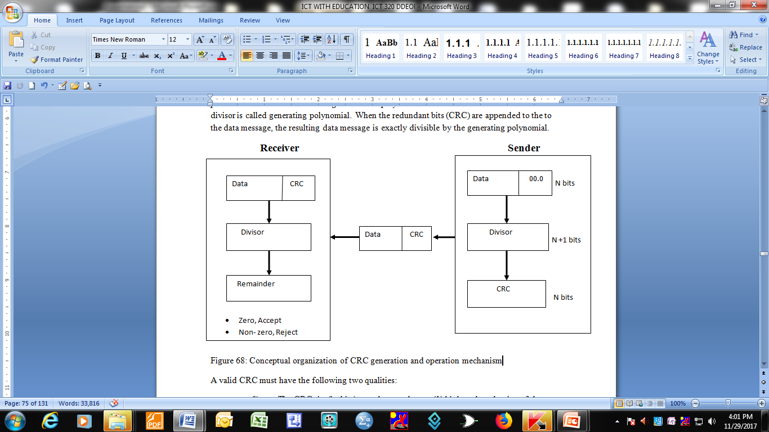
Conceptual organization of CRC generation and operation mechanism

Slide 4
A valid CRC must have the following two qualities:
The CRC size(in bits) must be exactly one (1) bit less than the size of the divisor(generating polynomial)
Appending the CRC to the message must make the message exactly divisible by the generating polynomial(divisor)

Slide 5
Operation
The above diagram (operates as follows:
A string of n zeros (0s) is appended to the data unit.
The number n (bits) is 1 bit less than the divisor which is N+1 bits.
The newly elongated data unit is divided by the divisor using modulo-2 arithmetic.
The remainder of this division is the CRC. The quotient is discarded. The CRC of N bits replaces the zeros (0s) at the data unit.
It is also possible to have CRC of all zeros (0s).

Slide 6
The data unit arrives first at the receiver followed by the CRC
The receiver treats the whole string as a unit and divides it by the same divisor used at the transmitter to produce the CRC
If the string was received without error, the CRC checker will give a remainder of zero (0)
If the string was received with errors the remainder will be non-zero and the data unit ill be rejected.

Slide 7
Modulo-2 binary division operates as follows:
0 – 0 = 0
1 – 0 = 1
1 – 1 = 0
0 – 1 = 1

Slide 8
Example 1
Consider a data frame 100100 to be transmitted. The generating polynomial (divisor) to be used is: x³ + x² +1. (Note that the least significant bit of the generating polynomial must always be a binary 1. So a binary 1 is always added to it. The generating polynomial translates into:
x³ + x² + x + 1 = 1101. Since the divisor is four (4) bits, the CRC must be one bit less, that is 3 bits.
So three zeros (000) are appended to the data unit and it becomes 100100000. The elongated data unit is then divided by the divisor to get the CRC using modulo-2 arithmetic.

Slide 9
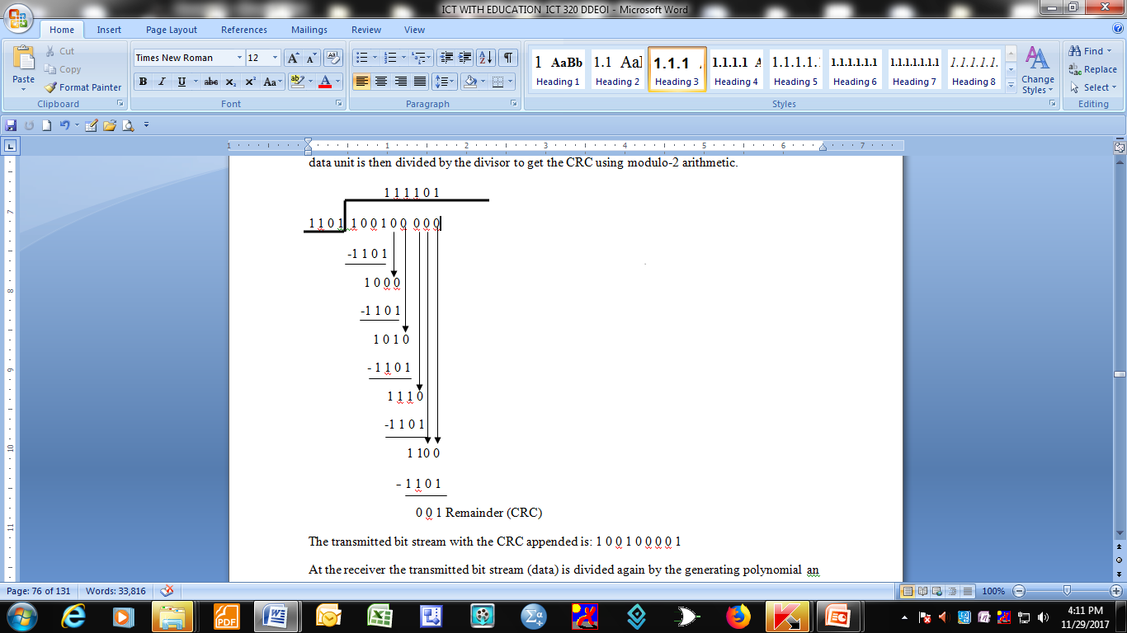

Slide 10
The transmitted bit stream with the CRC appended is: 1 0 0 1 0 0 0 0 1
At the receiver the transmitted bit stream (data) is divided again by the generating polynomial an dif the remainder is zero it means no errors occurred during transmission.
A non- zero remainder indicates that error(s) occurred during transmission

Slide 11
Example 2
The transmitted message is 1 0 0 1 0 0 0 0 1.
We check for the presence/absence of errors by dividing this message with generating polynomial used at the transmitter:

Slide 12
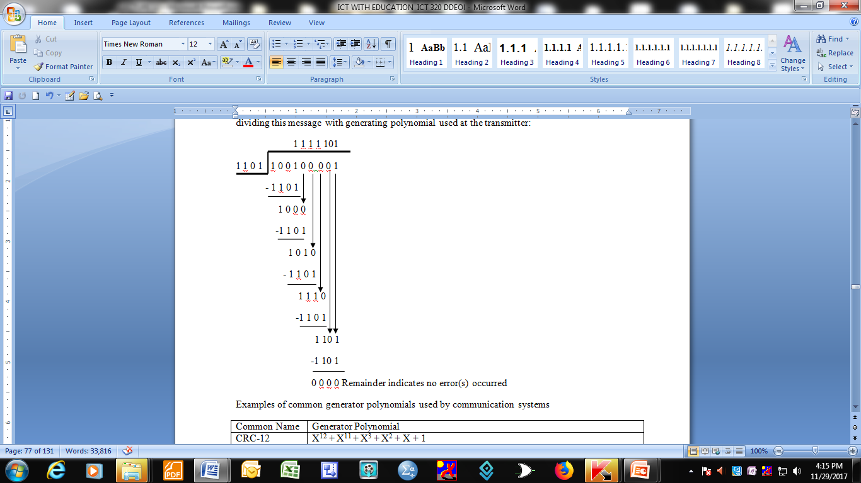

Slide 13
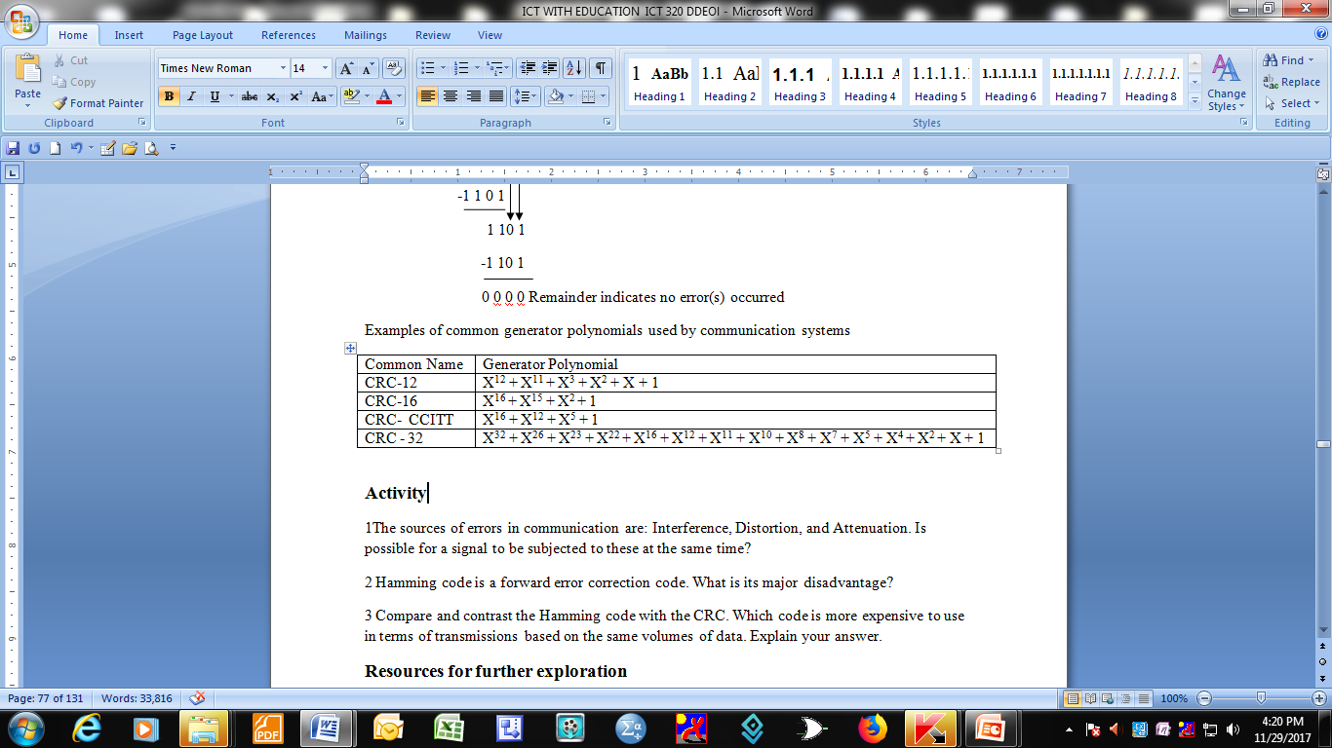
Examples of common generator polynomials used by communication systems

